Slide 1

Predicting Airbnb nightly prices A regression problem using machine learning

Slide 2



Slide 3



Founded
Profitable
- $320 mln
2008
2016
2019
2009
2018
2020
Rebranded
+ $200 mln
Covid

Slide 4








Mined
Read
Data
Literature
Machine
Human
Intelligence
Knowledge
Wisdom

Slide 5

KNOWLEDGE
KEY FEATURES
Distance to center
Renting entire home
Home size
SOCIAL ASPECTS
Trust in the host is essential
Host profile is important
Homogeny is present and prevalent
Evidence of ethnic differentiation of hosts

Slide 6






PHOTOGRAPHY - Could be holding much information – shows promise as a feature - Should also look into host’s photos – trust is important

Slide 7



Slide 8


Slide 9













DATA STREAM
Takes input
Time
Storage
Manual labor
Downloads
Un-archives
Data stored on web
Automatization
Cleans data
Structures folders
Distributed computing
Alerts user

Slide 10
THE DATA
3 file types
LISTINGS
CALENDAR
REVIEWS
Continuous, text, geo, categorical
Extensive munging
Data analysis
Machine Learning
Currency is €
Time series
Data compression
Time series analysis
Forecasting
Very messy
Text
NLP
Sentiment Analysis
Text analytics
Feature engineering

Slide 11


RANDOM FORESTS
Bagging of data and features
Limits overfitting
RF is easier to tune
Feature importance
Limited pre-processing
XGBOOST
Parallel tree growing
Prone to overfitting with noisy data
Difficult to tune hyperparameters
Uses gradient, loss function
Uses regularization term
Feature importance
Limited pre-processing
Sequential tree growing

Slide 12
EXPERIMENT PHASES
I. Amsterdam data
Baseline model
II. Amsterdam + photos
Size, Weekly price, Entire home, Cleaning fee, Quick response time, Photography score, Distance
III. All 10 cities data
City, Distance, Size, Cleaning fee, Sentiment
IV. Copenhagen – Paris and Athens – Berlin pairs
RMSE, MAE close to III. R2 lower
V. 9 cities (10 – Amsterdam)
Lower RMSE, MAE, also lower R2

Slide 13
RESULTS

Slide 14

TRAIN VS TEST R2
XGBoost 3
RMSE 24€
MAE 17€
R2 64%

Slide 15
TAKE AWAYS
Some differences between cities
Copenhageners don’t ask for deposits
Many in Prague hold multiple listings
London and Paris lowering prices, Vienna and Prague growing fast
Not enough data
Most researchers have an R2 under 70%
Photography & host info show promise
Sampling
More data is better
Removing “Outlier” cities can decrease error

Slide 16







Slide 17

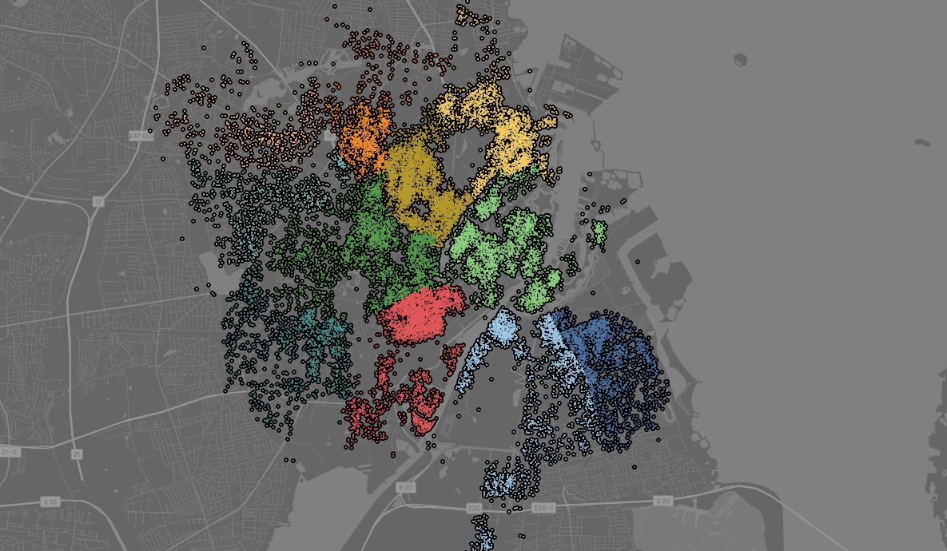
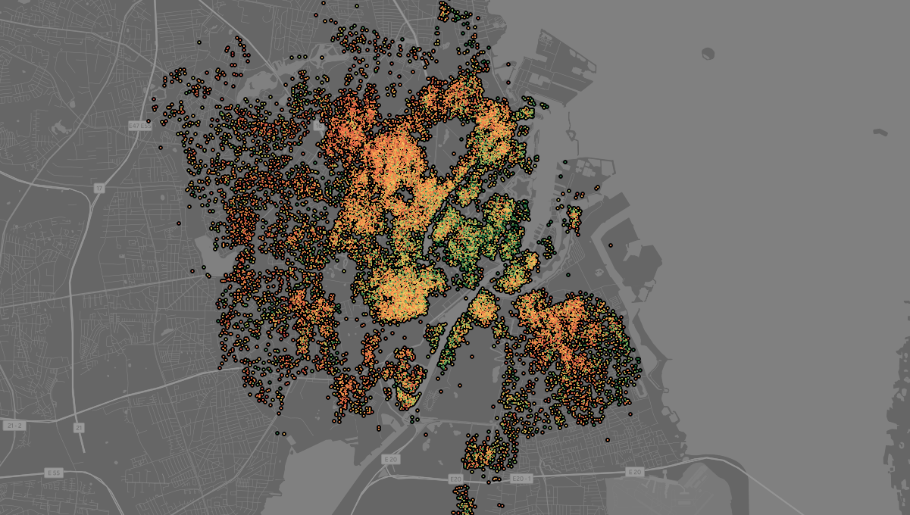
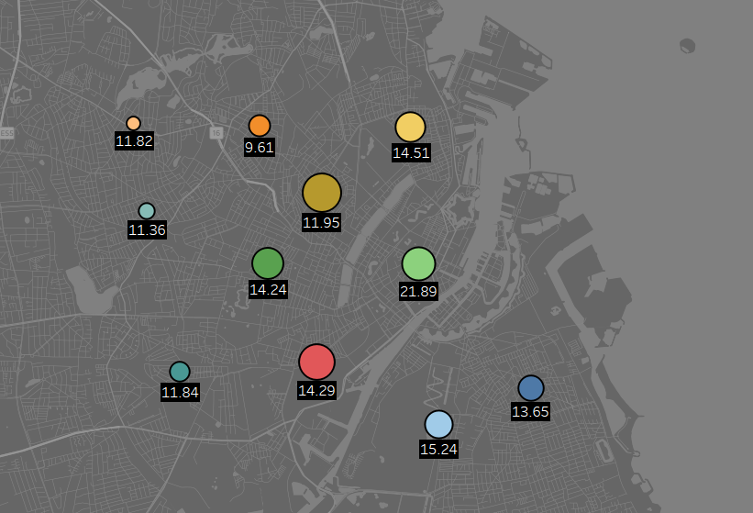

Slide 18


